Slide 1

Advanced Java Programming
(22517)

Slide 2
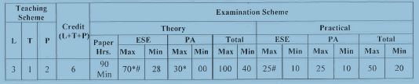
Teaching and Examination Scheme

Slide 3
AJP Chapters
Chapter # | Chapter Name | Marks (As per Syllabus)
01 | Abstract Windowing Toolkit(AWT) | 12
02 | Swings | 10
03 | Event Handling | 12
04 | Networking Basics | 10
05 | Interacting with Database | 12
05 | Servlets & JSP | 14

Slide 4
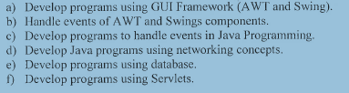
Course Outcomes(Cos)

Slide 5
Abstract Windowing Toolkit (AWT)
12 Marks
4

Slide 6
GUI (Graphical User Interface)
GUI offers user interaction via some graphical components.
Window, frame, Panel, Button, Textfield, TextArea, Listbox, Combobox, Label, Checkbox etc.
Using these components we can create an interactive user interface for an application.
GUI provides result to end user in response to raised event.
GUI is entirely event based.

Slide 7

GUI (Graphical User Interface)
button
menus
title bar
menu bar
combo box
scroll bars

Slide 8
AWT (Abstract Window Toolkit)
AWT contains numerous classes and methods
that allow you to create and manage window.
import java.awt.*;
Java AWT is a platform dependent API to develop GUI or window-based application in java.
Java AWT components are platform-dependent because components are displayed according to the view of operating system.
AWT components are heavyweight because components are created by underlying operating system.

Slide 9
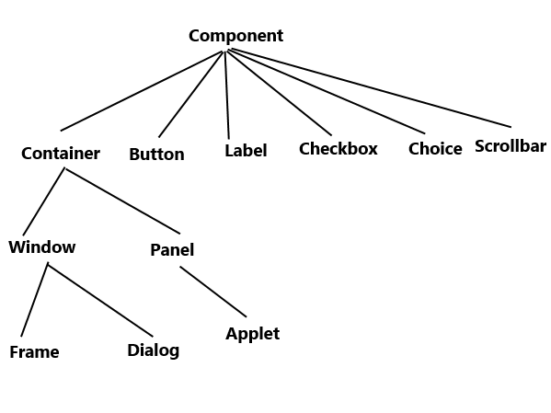
AWT Class Hierarchy
9

Slide 10
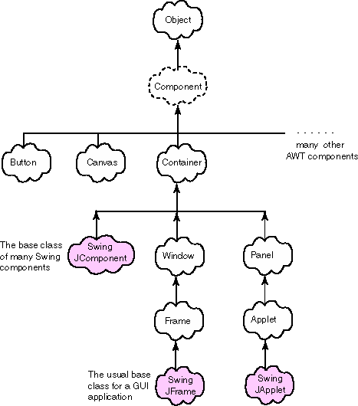
AWT Class Hierarchy : Detailed
Checkbox, Choice, Label, List, Scrollbar, ScrollPane, TextArea, TextField

Slide 11
Component
All the elements like buttons, text fields, scrollbars etc are known as components
In AWT we have classes for each component .
Component is an object having a graphical representation that can be displayed on the screen and that can interact with the user.
At the top of the AWT hierarchy is the Component
class.
It defines many public methods that are responsible for managing events, positioning and sizing the window, current foreground and background colors and the currently selected text font and repainting.

Slide 12
Component
_________ object is responsible for remembering the current foreground and background colors and the currently selected text font?
Answer: Component

Slide 13
Container
Container class is a subclass of Component.
Provided additional methods that allow other
Component to place on it.
Container contains and controls the layout of components.
Container is responsible for laying out (that is, positioning) any components that it contains.
It does this through the use of various layout managers.
A container itself is a component thus we can add a container inside container.

Slide 14
Container
Container is a component in AWT that can contain another components like buttons, text fields, labels etc.
The classes that extends Container class are known as container such as Frame, Dialog and Panel.

Slide 15
Containers and Components
The job of a Container is to hold and display Components
Some common subclasses of Component are Button, Checkbox, Label, Scrollbar, TextField, and TextArea
A Container is also a Component
Some Container subclasses are Panel (Applet, JApplet), Window (Frame, JFrame)

Slide 16
Panel
Panel is a concrete subclass of Container.
It doesn’t add any new methods which simply implements Container.
Panel is the immediate superclass of Applet. When screen output is directed to an applet, it is drawn on the surface of a Panel object.
Panel is one type of container that does not contain a title bar, menu bar, or border.
When you run an applet using an applet viewer, the applet viewer provides the title and border.

Slide 17
Applets
Applet is a public class which is predefined by
java.applet package.
There is no main() method in Applet like Application program. The main() method is defined by browser or Appletviewer for Applet.
Life cycle methods: init, start, paint, stop, destroy
Applet is one type of container and subclass of Panel.
Applet is superclass of JApplet

Slide 18
To create an applet
import java.applet.*;
Import java.awt.*;
Applet code in comment.
Extends Applet class
Life cycle method
Class must be public

Slide 19
Window
Creates top-level window means directly on
the desktop.
Don’t create Window objects directly.
The window is the container that have no
borders and title.
Use Frame & Dialog class which is subclass of Window class for creating window.

Slide 20
Frame
It is subclass of Window and has a title bar, menu bar, borders, and resizing corners.
It can contain several components like buttons, text fields, scrollbars etc.
We can create a GUI using Frame in two ways: 1) By extending Frame class 2) By creating the instance of Frame class

Slide 21
Working with Frame Window
Extends Frame class
Constructor are:
Frame()
Frame(String title)
Setting and Getting window size:
void setSize(int width, int height)
void setSize(Dimension newsize)
Dimension getSize()
Showing and Hiding Frame
void setVisible(boolean visibleFlag)

Slide 22
Working with Frame Window
Setting title to frame
void setTitle(String title)
Closing Frame:
Implements WindowListener interface.
Extends WindowAdapter class.

Slide 23
AWT Controls & Layout Manager
AWT Controls: Component which allows you to interact with application.
Labels
Button
Checkbox
Checkbox group
Scrollbars
Text field
Text Area

Slide 24
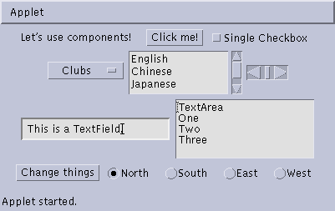
Some types of components
Button
Checkbox
Label
Choice
Scrollbar
TextField
List
TextArea
Button
Checkbox
CheckboxGroup

Slide 25
Layout Manager: Positioning the components in the
container.
Flow Layout
Border Layout
Grid Layout
Card Layout
Grid Bag Layout
Menubars, menus, dialog boxes, file dialog.

Slide 26
AWT Controls:
Allows user to interact with application.
Adding the control in Window
First create instance of control.
Call add() method defined by container
Component add(Component compObj)
Removing the Control
Call remove() method defined by container
void remove(Component obj)
For remove all: removeAll() method call.

Slide 27
AWT Control: Label
Used to just display string on window.
Passive Components
Constructors:
Label( )
Label(String str) //left - justified
Label(String str, int how) // Label.LEFT, Label.RIGHT, Label.CENTER
Methods to perform operation: Setter and Getter Method.
About text:
void setText(String str)
String getText( )
About Alighment
void setAlignment(int how)
int getAlignment( )

Slide 28
AWT Control: Button
It contains a label and that generates an event when it is
pressed.
Active Components
Constructors:
Button( )
Button(String str)
Methods to perform operation: Setter and Getter Method.
void setLabel(String str)
String getLabel( )

Slide 29
AWT Control: Button Handling
When Button pressed which generates an event when it is pressed.
Implements ActionListener interface.
Interface has defined actionPerformed() method, called when event is generated.
ActionEvent object is supplied as argument to the
method.
ActionEvent object refers both Button and Label of
Button
Label will get by using getActionCommand() from ActionEvent which passed.

Slide 30
AWT Control: CheckBox
Used to turn an option on or off.
Small box: check mark or not.
Each check box has label.
Constructors are:
Checkbox( )
Checkbox(String str)
Checkbox(String str, boolean on)
Checkbox(String str, boolean on, CheckboxGroup cbGroup)
Checkbox(String str, CheckboxGroup cbGroup, boolean on)

Slide 31
AWT Control: CheckBox
Setter and Getter methods:
boolean getState( )
void setState(boolean on)
String getLabel( )
void setLabel(String str)
The value of on determine initial state (true/false).

Slide 32
AWT Control: CheckBox
Handling
Check box is selected or deselected, an item event is generated.
For handling implements ItemListener interface
ItemListener interface is defines itemStateChanged( )
method.
ItemEvent object is supplied as the argument.
getState() : Get Status about checkbox.
Following methods determine and set status:
Checkbox getSelectedCheckbox( )
void setSelectedCheckbox(Checkbox which)

Slide 33
AWT Control: Choice Class
Used to create a pop-up list items.
Default constructor Choice() create empty list.
Each item in the list is a string that appears as a left-justified label in the order it is added to the Choice object.
For add item in list
void add(String name)
To determine selected item:
String getSelectedItem( )
int getSelectedIndex( )
String getItem(int index)

Slide 34
AWT Control: Choice Class
To get Item Count
int getItemCount( )
To select Item
void select(int index)
void select(String name)

Slide 35
AWT Control: Handling Choice
When Choice selected, an item event is generated.
Implements the ItemListener interface.
Interface defines the itemStateChanged( ) method.
ItemEvent object is supplied as the argument to this method.

Slide 36
AWT Control: List
List class provides a compact, multiple-choice, scrolling selection list.
List object can be constructed to show any number of choices in the visible window.
In Choice only one item is shown.
Constructors
List( )
List(int numRows)
List(int numRows, boolean multipleSelect)

Slide 37
AWT Control: List
Following methods are used to add items:
void add(String name)
void add(String name, int index)
For single selection items:
String getSelectedItem( )
int getSelectedIndex( )
For Multiple selection items:
String[ ] getSelectedItems( )
int[ ] getSelectedIndexes( )

Slide 38
AWT Control: List
To retrieve item:
String getItem(int index)
To get Item Count
int getItemCount( )
Active Item
void select(int index)
void select(String name)

Slide 39
AWT Control: List Handling
Two types of event generated:
For double clicked: ActionEvent generated.
For select and deselect item: ItemEvent generated.
Implements ActionListener interface and ItemListener.

Slide 40
AWT Control: Scrollbar
enable user to select from range of values.
Used to select continuous values between a specified minimum and maximum.
Scroll bars may be oriented horizontally or vertically.
Each end has an arrow , when clicked moves the current value of the scroll bar one unit in the direction of the arrow.
The current value of the scroll bar is indicated by the slider box for the scroll bar.
The slider box can be dragged by the user to a new position.

Slide 41
AWT Control: Scrollbar
Constructors:
Scrollbar( ) : construct new vertical scrollbar
Scrollbar(int style) : : construct new scrollbar with style orientation
Scrollbar(int style, int initialValue, int thumbSize, int min, int max)
style : Scrollbar.VERTICAL or Scrollbar.HORIZONTAL
To set Values:
void setValues(int initialValue, int thumbSize, int min, int
max)
To get and set current value:
int getValue( )
void setValue(int newValue)

Slide 42
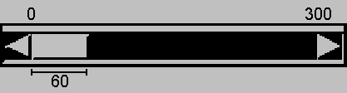
AWT Control: Scrollbar
to get Min and Max value:
int getMinimum( )
int getMaximum( )
By default unit increment/decrement is 1 and Block page-up and page-down increment/decrement is 10.
to change increment :
void setUnitIncrement(int newIncr)
void setBlockIncrement(int newIncr)

Slide 43
AWT Control: Handling
Scrollbar
AdjustmentEvent is generated.
Implement the AdjustmentListener interface.
adjustmentValueChanged() method we have to override
getAdjustmentType( ) method can be used to determine the type of the adjustment.
BLOCK_DECREMENT: A page-down event has been generated.
BLOCK_INCREMENT: A page-up event has been generated.
TRACK: An absolute tracking event has been generated.
UNIT_INCREMENT : user clicks in the right arrow of a horizontal scroll bar, or the bottom arrow of a vertical scroll bar
UNIT_DECREMENT : User clicks in the left arrow of a horizontal sc bar, or the top arrow of a vertical scroll bar.

Slide 44
AWT Control: TextField
TextField is subclass of TextComponent. TextComponent is subclass of Component.
TextField class implements a single-line text-entry area, usually called an edit control.
Text fields allow the user to enter strings and to edit the text using the arrow keys, cut and paste keys, and mouse selections.
Constructors:
TextField( )
TextField(int numChars)
TextField(String str)
TextField(String str, int numChars)

Slide 45
AWT Control: TextField
Setter and Getter Method of TextField and TextComponent:
String getText( )
void setText(String str)
Particular Text selection:
String getSelectedText( )
void select(int startIndex, int endIndex)
About Modification of Text:
boolean isEditable( )
void setEditable(boolean canEdit)

Slide 46
AWT Control: TextField
Setting echo character to text field and related methods:
void setEchoChar(char ch)
boolean echoCharIsSet( )
char getEchoChar( )
ActionEvent generates.
Implements ActionListener Class

Slide 47
AWT Control: TextArea
Sometimes a single line of text input is not enough for a given task.
It is multiline text editor
Subclass of TextComponent.
Constructors:
TextArea( )
TextArea(int numLines, int numChars)
TextArea(String str)
TextArea(String str, int numLines, int numChars)
TextArea(String str, int numLines, int numChars, int sBars)

Slide 48
AWT Control: TextArea
The values of sbar:
SCROLLBARS_BOTH
SCROLLBARS_NONE
SCROLLBARS_HORIZONTAL_ONLY
SCROLLBARS_VERTICAL_ONLY
It supports: getText( ), setText( ), getSelectedText( ), select( ), isEditable(), and setEditable( )
Other some methods:
void append(String str)
void insert(String str, int index)
void replaceRange(String str, int startIndex, int endIndex)

Slide 49
Arranging components : Layout Manager
Layout means the arrangement of components within the container.
Layout manager automatically positions all the components within the container.
LayoutManager is an interface that is implemented by all the classes of layout managers.

Slide 50
Arranging components : Layout Manager
Every Container has a layout manager
The default layout for a Panel and Applet is FlowLayout
The default layout for a Window,Frame and Dialog is a BorderLayout
We could set it explicitly with: setLayout()
setLayout (new lowLayout( ));

Slide 51
Different Layout Manager
FlowLayout
BorderLayout
GridLayout
CardLayout
GridBagLayout

Slide 52
FlowLayout
It is used to arrange the components in a line, one after another (in a flow).
Components are added left-to-right.If no room, a new row is started
Components are made as small as possible
It is the default layout of applet or panel.
Constructors:
FlowLayout()
FlowLayout(int alignment)
FlowLayout(int alignment,int horz_gap,int vert_gap)
Deault gap is 5 pixels and aligns center

Slide 53
FlowLayout
Alignment can be set to one of the following constant:
FlowLayout.LEFT
FlowLayout.RIGHT
FlowLayout.CENTER
Use add(component);
to add a component when using FlowLayout

Slide 54
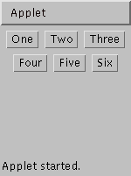
example:
FlowLayout
import java.awt.*;
import java.applet.*;
public class FlowLayoutExample extends Applet
{
public void init ()
{
setLayout (new FlowLayout ()); // default
add (new Button ("One"));
add (new Button ("Two"));
add (new Button ("Three"));
add (new Button ("Four"));
add (new Button ("Five"));
add (new Button ("Six"));
}
}

Slide 55
BorderLayout
Divides the container display area into 5 regions: EAST,WEST,SOUTH,NORTH and CENTER.
i.e arranges the components in 5 regions
Each region (area) may contain one component only.
It is the default layout of frame or window
If you want more components, add a Panel, then add components to it.
Constructor :
BorderLayout()
BorderLayout(int horz_gap,int vert_gap)

Slide 56
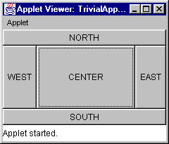
BorderLayout
Use add(component,region);
to add a component when using BorderLayout
Region constants can be :
BorderLayout.EAST
BorderLayout.WEST
BorderLayout.SOUTH
BorderLayout.NORTH
BorderLayout.CENTER

Slide 57
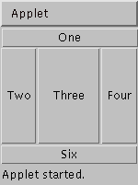
example:
BorderLayout
import java.awt.*;
import java.applet.*;
public class BorderLayoutExample extends Applet
{ public void init ()
{
setLayout (new BorderLayout());
add(new Button("One"), BorderLayout.NORTH);
add(new Button("Two"), BorderLayout.WEST);
add(new Button("Three"), BorderLayout.CENTER);
add(new Button("Four"), BorderLayout.EAST);
add(new Button("Five"), BorderLayout.SOUTH);
add(new Button("Six"), BorderLayout.SOUTH);
}
}

Slide 58
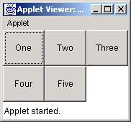
GridLayout
The GridLayout manager divides the container up into a given number of rows and columns
All sections of the grid are equally sized and as large as possible
Constructor:
GridLayout()
GridLayout(int rows, int columns) –no gap
GridLayout(int rows, int columns, int horz_gap,int vert_gap)

Slide 59
example: GridLayout
import java.awt.*;
import java.applet.*;
public class GridLayoutExample extends Applet
{
public void init ()
{
setLayout(new GridLayout(2, 3));
add(new Button("One"));
add(new Button("Two"));
add(new Button("Three"));
add(new Button("Four"));
add(new Button("Five"));
}
}

Slide 60
CardLayout
The class CardLayout arranges each component in the container as a card.
Only one card is visible at a time, and the container acts as a stack of cards.
Cards are typically held in an object of type Panel.
Panel must have CardLayout selected as its layout manager.
Constructors:
CardLayout()- zero gap
CardLayout(int hgap, int vgap)

Slide 61
CardLayout
To Add component/card:
void add(Component panelObj, Object name);
Methods:
void first(Container deck)
void last(Container deck)
void next(Container deck)
void previous(Container deck)
void show(Container deck, String cardName)

Slide 62
GridBagLayout
GridBagLayout arranges components in a horizontal , vertical or along their baseline
GridBagLayout is the most complex and flexible of the standard layout managers.
The components may not be of same size. and can occupy multiple rows or columns.
The position and behavior of each element is specified by an instance of the GridBagConstraints class.
Each component occupies one or more cells known as its display area.
.

Slide 63
GridBagLayout
.
GridBagConstraints specifies how the component is laid out within its display area
Constructor:
GridBagLayout()

Slide 64
GridBagLayout
For customize a GridBagConstraints object by setting one or more of its instance variables:
gridx, gridy:
Specifies the cell at the upper left of the component's display area, The leftmost column has address gridx=0 and the top row has address gridy=0
gridwidth, gridheight:
Specifies the number of columns(for gridwidth) or rows
(for gridheight) in the component's display area. The default value is 1.
fill:
Used when the component's display area is larger than the component's requested size to determine whether (and how) to resize the component.
Valid values:
GridBagConstraints.HORIZONTAL
GridBagConstraints.VERTICAL
GridBagConstraints.BOTH
GridBagConstraints.NONE

Slide 65
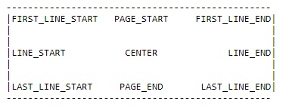
GridBagLayout
Anchor
Used when the component is smaller than its display area to determine where (within the area) to place the component.
ipadx, ipady:
Specifies the internal padding: how much to add to the size of the component. The default value is zero

Slide 66
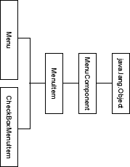
MenuBar and Menu

Slide 67
MenuBar and Menu
Top-level window can have a menu bar associated with it.
A menu bar displays a list of top-level menu choices.
Each choice is associated with a drop-down menu.
Classes:
MenuBar : Contains one or more Menu objects
Menu : Contains one or more MenuItem objects
MenuItem : Object something selected by user.
It is also possible to include checkable menu items
These are menu options of type CheckboxMenuItem and will have a check mark next to them when they are selected.

Slide 68
MenuBar and Menu
To create a menu bar, first create an instance of
MenuBar.
Set MenuBar using setMenuBar(MenuBarObject)
Next, create instances of Menu that will define the selections displayed on the bar.
Constructors:
Menu( )
Menu(String optionName)
Menu(String optionName, boolean removable)
Individual menu items constructors:
MenuItem( )
MenuItem(String itemName)
MenuItem(String itemName, MenuShortcut keyAccel)

Slide 69
MenuBar and Menu
Disable or enable a menu item by using:
void setEnabled(boolean enabledFlag)
boolean isEnabled( )
Label set and get using:
void setLabel(String newName)
String getLabel( )
Checkable menu item by using a subclass of MenuItem
called CheckboxMenuItem. :
CheckboxMenuItem( )
CheckboxMenuItem(String itemName)
CheckboxMenuItem(String itemName, boolean on)

Slide 70
MenuBar and Menu
Status about checkable MenuItem:
boolean getState( )
void setState(boolean checked)
For add MenuItem:
MenuItem add(MenuItem item)
For add Menu to MenuBar
Menu add(Menu menu)
To get Item from Menu:
Object getItem( )

Slide 71
Dialog Box
Dialog boxes are primarily used to obtain user input.
They are similar to frame windows, except that dialog boxes are always child windows of a top-level window.
Dialog boxes don’t have menu bars.
In other respects, dialog boxes function like frame windows.
Dialog boxes may be modal or modeless.
When a modal dialog box is active, all input is directed to it until it is closed.
When a modeless dialog box is active, input focus can be directed to another window in your program.

Slide 72
Dialog Box
Constructors:.
Dialog(Frame parentWindow, boolean mode)
Dialog(Frame parentWindow, String title, boolean mode)
To create Dialog Box:
Create Frame or Applet
Create another class which extends Dialog class.
Call this new class from Frame/Applet class.
In constructor of Extended Dialog class, use super method and pass vales to constructor of Dialog.

Slide 73
FileDialog
Java provides a built-in dialog box that lets the user specify a file.
To create a file dialog box, instantiate an object of type
FileDialog.
Constructor:
FileDialog(Frame parent, String boxName)
FileDialog(Frame parent, String boxName, int how)
FileDialog(Frame parent)
how: FileDialog.LOAD, FileDialog.SAVE
Methods:
String getDirectory( ) String getFile( )

Slide 74
Introduction to Swing
Package : javax.swing.*
Swing is set of classes which provides more powerful and flexible components as compare to AWT.
Swing is a part of JFC (Java Foundation Classes)
JFC are a set of GUI components which simplify the development of desktop applications.
Build on top of AWT API and acts as replacement of AWT API.

Slide 75
Introduction to Swing
Swing component follows a Model-View-Controller architecture
Swing actually makes use of a simplified variant of the MVC design called the model-delegate .
Swing Components are implemented using Java and so they are platform independent.
Called lightweight components
100 % Java implementations of components.
Use MVC architecture.
Model represents the data
View as a visual representation of the data
Controller takes input and translates it to changes in data

Slide 76
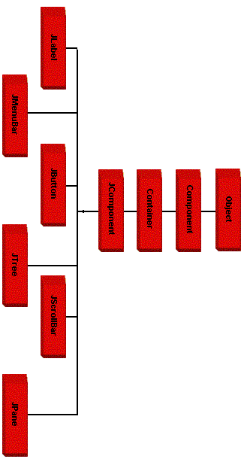
Introduction to Swing

Slide 77
Difference Between AWT & Swing
No. | Java AWT | Java Swing
1) | AWT components are platform-dependent. | Java swing components are platform-independent.
2) | AWT components are heavyweight. | Swing components are lightweight.
3) | AWT doesn't support pluggable look and feel. | Swing supports pluggable look and feel.
4) | AWT provides less components than Swing. | Swing provides more powerful components such as tables, lists, scrollpanes, colorchooser, tabbedpane etc.
5) | AWT doesn't follows MVC(Model View Controller | Swing follows MVC.

Slide 78
Important Classes by Swing
Abstract Button
ButtonGroup
ImageIcon
JApplet
JButton
JCheckBox
JComboBox
JLabel
JRadioButton
JScrollPane
JTabbedPane
JTable
JTextField
JTree

Slide 79
MVC Architecture
Software design pattern for software development.
Model:
The model encompasses the state data for each component.
Database and logic.
View:
The view refers to how you see the component on the screen
User Interface
Controller:
dictates how the component interacts with events
controller is responsible for handling events on the component
Communication logic/integration logic

Slide 80
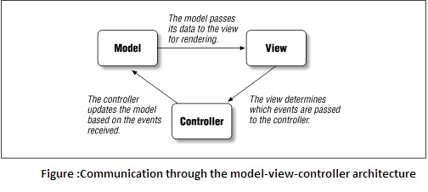
MVC Architecture(Basic)

Slide 81
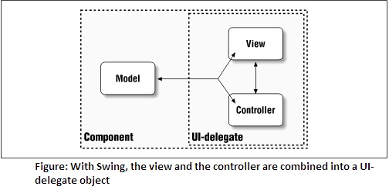
Modified MVC Architecture

Slide 82
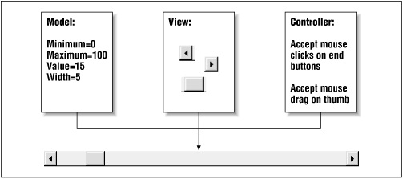
MVC Architecture : Scrollbar example

Slide 83
JApplet
The JApplet class extends the Applet class
JApplet supports various “panes,” such as the content pane, the glass pane, and the root pane.
Components are added to the content pane of the JApplet object.
content pane can be obtained via Call
Container getContentPane( )
The add( ) method of Container can be used to add a component to a content pane.
default layout for JApplet is BorderLayout

Slide 84
JFrame
The JFrame class extends the Frame class
Components are added to the content pane of the JFrame object.
content pane can be obtained via Call
Container getContentPane( )
The add( ) method of Container can be used to add a component to a content pane.
default layout for JFrame is BorderLayout
For JFrame close operation: setDefaultCloseOperation()
Parameters:
DISPOSE_ON_CLOSE
EXIT_ON_CLOSE
DO_NOTHING_ON_CLOSE

Slide 85
JLabel
Small display area for text, image or both.
Extends Jcomponent.
Constructors:
JLabel()
JLabel(Icon i)
Label(String s)
JLabel(String s, Icon i, int align)
align argument is either LEFT, RIGHT, CENTER,
methods:
Icon getIcon( )
String getText( )
void setIcon(Icon i)
void setText(String s)

Slide 86
ImageIcon
Icon is small fixed size picture, typically used to decorate components.
ImageIcon is an implementation of the Icon interface that paints icons from images.
Constructors:
ImageIcon(String filename)
ImageIcon(URL url)
methods
int getIconHeight( )
int getIconWidth( )

Slide 87
JTextField
java.lang.Object java.awt.Component
java.awt.Container
javax.swing.JComponent javax.swing.text.JTextComponent
javax.swing.JTextField
Allows us to edit single line of text
Constructors:
JTextField( )
JTextField(int cols)
JTextField(String s, int cols)
JTextField(String s)
Methods:
String getText( )
void setText(String s)

Slide 88
AbstractButton
Swing provide Icon with Button text.
Swing buttons are subclasses of the AbstractButton class, which extends JComponent.
AbstractButton contains many methods that allow us to
control the behavior of buttons, check boxes, and radio buttons
Methods to control the behavior:
void setDisabledIcon(Icon di)
void setPressedIcon(Icon pi)
void setSelectedIcon(Icon si)
void setRolloverIcon(Icon di)
Methods
String getText( )
void setText(String s)
.

Slide 89
JButton
Constructors:
JButton(Icon i)
JButton(String s)
JButton(String s, Icon i)
Methods
String getText( )
void setText(String s)
ActionEvent is generated.
ActionListener interface is needed to handle ActionEvent.
Public actionPerformed() used to override.

Slide 90
JCheckBox
java.lang.Object java.awt.Component
java.awt.Container
javax.swing.JComponent
javax.swing.AbstractButton javax.swing.JToggleButton
javax.swing.JCheckBox
Immediate superclass is JToggleButton
Constructor:
JCheckBox()
JCheckBox(Icon i)
JCheckBox(Icon i, boolean state)
JCheckBox(String s)
JCheckBox(String s, boolean state) JCheckBox(String s, Icon i)
JCheckBox(String s, Icon i, boolean state)

Slide 91
JCheckBox
Methods
String getText( )
void setText(String s)
void setSelected(boolean state)
ItemEvent is generated.
ItemListener interface is needed to handle ItemEvent.
Public itemStateChnaged() used to override.

Slide 92
JRadioButton
java.lang.Object java.awt.Component
java.awt.Container javax.swing.JComponent
javax.swing.AbstractButton javax.swing.JToggleButton
javax.swing.JRadioButton
Immediate superclass is JToggleButton
Constructor:
JRadioButton()
JRadioButton(Icon i)
JRadioButton(Icon i, boolean state) JRadioButton(String s)
JRadioButton(String s, boolean state) JRadioButton(String s, Icon i)
JRadioButton(String s, Icon i, boolean state)

Slide 93
JRadioButton
ButtonGroup class is used to add radio button in group.
ActionEvent is generated.
ActionListener Listener interface is needed to handle ActionEvent.
public void actionPerofrmed() used to override.
Methods
String getText( )
void setText(String s)

Slide 94
JComboBox
Combination of text field and drop down list.
Subclass of JComponet
Only one entry can view at a time.
Constructor:
JComboBox( )
JComboBox(Vector v)
void addItem(Object obj): Used to add object in Combobox
ItemEvent is generated.
Implements ItemListener interface
Override: itemStateChnaged(ItemEvent ie) method defined by ItemListener.
JComboBox: EventHandling

Slide 95
JTabbedPane
A tabbed pane is a component that appears as a group of folders in a file cabinet.
Each folder has a title.
When a user selects a folder, its contents become visible.
Only one of the folders may be selected at a time.
Tabbed panes are commonly used for setting configuration options.
Subclass of JComponent
Constructor:
JTabbedPane()
JTabbedPane(in tabPlacement)
values of tabPlacement: TOP,BOTTOM, LEFT,RIGHT

Slide 96
JTabbedPane
Tabs are defined via the following method :
void addTab(String str, Component comp)
Str: title of pane
Comp: component, it can be Jpanel
Steps to create JTabbedPane:
Create a JTabbedPane object.
Call addTab( ) to add a tab to the pane. Tab is created by extending JPanel class.
Repeat step 2 for each tab.
Add the tabbed pane to the content pane of the Japplet or JFrame

Slide 97
JScrollPane
A scroll pane is a component that presents a rectangular area in which a component may be viewed.
Horizontal and/or vertical scroll bars may be provided if
necessary.
Subclass of JComponent
Constructor:
JScrollPane()
JScrollPane(Component comp)
JScrollPane(int vsb, int hsb)
JScrollPane(Component comp, int vsb, int hsb)
Comp: Component, vsb and hsb: Scrollbar constant

Slide 98
JScrollPane
vsb and hsb are constants defined by ScrollPaneConstants
HORIZONTAL_SCROLLBAR_ALWAYS
HORIZONTAL_SCROLLBAR_AS_NEEDED
VERTICAL_SCROLLBAR_ALWAYS
VERTICAL_SCROLLBAR_AS_NEEDED
Steps to use JScrollPane:
Create a JComponent object.
Create a JScrollPane object.
Add Jcomponent object to JScrollPane object
Add the scroll pane to the content pane of the Japplet or JFrame
.

Slide 99
JTree
A tree is a component that presents a hierarchical view of data.
Trees are implemented in Swing by the JTree class, which
extends JComponent.
Constructors:
JTree(Hashtable ht)
JTree(Object obj[ ])
JTree(TreeNode tn)
JTree(Vector v)

Slide 100
JTree
The TreeNode interface declares methods that obtain information about a tree node.
The MutableTreeNode interface extends TreeNode. It declares methods that can insert and remove child nodes or change the parent node.
The DefaultMutableTreeNode class implements the
MutableTreeNode interface. It represents a node in a tree.
Constructor:
DefaultMutableTreeNode(Object obj)
To create a hierarchy of tree nodes, the add( ) method of
DefaultMutableTreeNode can be used.
void add(MutableTreeNode child)

Slide 101
JTree
A JTree object generates events when a node is expanded or collapsed.
Tree Expansion event described by class:
TreeExpansionEvent (Package: javax.swing.event)
The addTreeExpansionListener( ) and removeTreeExpansionListener( ) methods allow listeners to register and unregister for these notifications.
Signature for these methods:
void addTreeExpansionListener(TreeExpansionListener tel)
void removeTreeExpansionListener(TreeExpansionListener
tel)
TreeExpansionListener interface provides the following two methods
void treeCollapsed(TreeExpansionEvent tee)
void treeExpanded(TreeExpansionEvent tee)

Slide 102
JTree
The getPath( ) method of this class returns a TreePath.
TreePath getPath( )
TreePath getPathForLocation(int x, int y):
TreePath object that encapsulates information about the tree node that was selected by the user.
Steps to create Jtree:
Create a JTree object.
Create a JScrollPane object.
Add the tree to the scroll pane.
Add the scroll pane to the content pane of the applet.

Slide 103
JTable
A table is a component that displays rows and columns of data.
Subclass of JComponent
Constructor:
JTable(Object data[ ][ ], Object colHeads[ ])
data is a two-dimensional array of the information
colHeads is a one-dimensional array with the column headings.
Steps to create Jtable
Create a JTable object.
Create a JScrollPane object.
Add the table to the scroll pane.
Add the scroll pane to the content pane of the JApplet or JFrame

Slide 104
JSeparator
It inherits JComponent class.
used to draw a line to separate widgets in a Layout.
provides a horizontal or vertical dividing line or empty space.
most commonly used in menus and tool bars
Menus and toolbars provides methods that create and add separator
For ex:
menu.add(menuitem1);
menu.add(menuitem2);
menu.addSeparator();
menu.add(menuitem3);
menu.add(menuitem4);

Slide 105
JSeparator
Constructors
JSeparator() : Create a horizontal separator.
JSeparator(int orientation) : Create a horizontal or vertical separator.
Orientation is defined by SwingConstants
SwingConstants.HORIZONTAL
SwingConstants.VERTICAL
Methods:
void setOrientation(int orientation )
int getOrientation()

Slide 106
JToolTip
Used to display a "Tip" for a Component
Any Swing component can use the setToolTipText() method to specify the text for a standard tooltip.
For ex:
JButton b1=new JButton(“Submit”);
b1.setToolTipText(“Click this button to store your data”);
Or
b1.setToolTipText(“<html>Click this button <br> to store your data </html>”);
Methods:
void setToolTipText(“String str)
String getToolTipText()

Slide 107
JProgressBar
visually displays the progress of some specified task
Shows percentage of completion of specified task
Constructor:
JProgressBar()
JProgressBar(int orientation) SwingConstants.VERTICAL SwingConstants.HORIZONTAL
JProgressBar(int min, int max) :
JProgressBar(int orientation, int min, int max)

Slide 108
JProgressBar Methods
int getMaximum()
int getMinimum()
String getString()
void setMaximum(int n)
void setMinimum(int n)
void setValue(int n)
void setString(String s)
Void setStringPainted(boolean painted)

